Slide 1
NDIC Data Getter
Automation that retrieves Shapes from NDIC’s GIS Library

Slide 2
What Data are we getting?
'BLMLands’
'CasesDocketed’
,'CityBoundaries’
,'CountyBoundaries’
,'CountyRoads’
,'Directionals’
,'Directionals_Lines’
,'DrillingSpacingUnits’
,'FederalForestService’
,'FedForestService’
,'FortBerthold_Mineral’
,'FortBerthold_Surface’
,'GasPlants’
,'Horizontals’
,'Horizontals_Lines’
,'InspectorAreas’
,'MajorRivrs’
,'MajorRoads’
,'MissouriRiver’
,'NDLandDept’
,'OilFields’
,'PermitStatusBeforeSpud’
,'Reservations’
,'Rigs’
,'Sections’
,'Seismic2DPreplot’
,'Seismic3DPreplot’
,'Townships’
,'UnitBoundaries’
,'Wells',]

Slide 3
Where is the Data Going?

Slide 4
What is the data being used for?

Slide 5
How is it being copied?

Slide 7







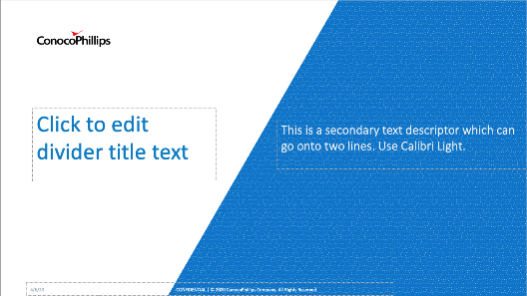
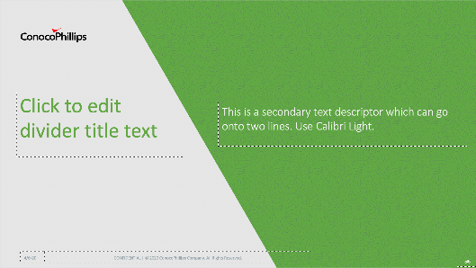

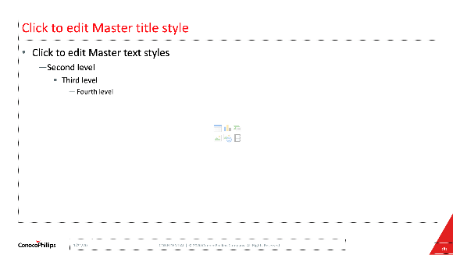
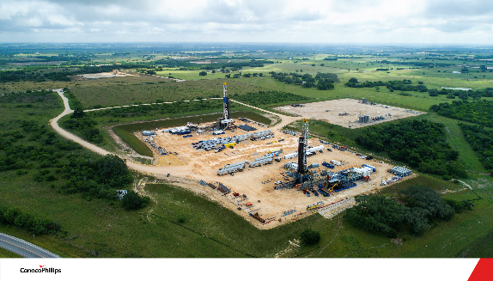

New presentation options
Choose from five color options, starting with the cover slide.
Go to LAYOUT in PowerPoint to see dividers in five color options. (See how on slide 4.)
New content page accommodates a full-slide photo.
Crop photos so that ConocoPhillips logo is always visible.

Slide 8
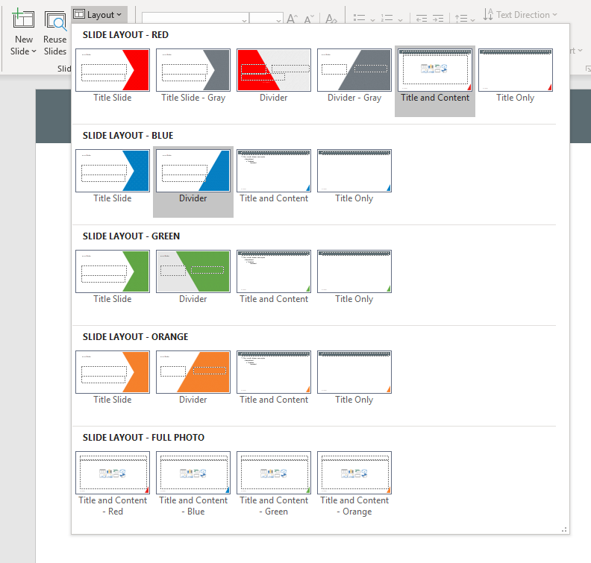



Getting Started
Click the down arrow by New Slide or Layout to see all available slide layouts.
Best Practices:
Stay with one color theme
Do not drag other slides into this template (See Slide 4 for how to migrate content)
Leave clear space around the ConocoPhillips logo

Slide 9
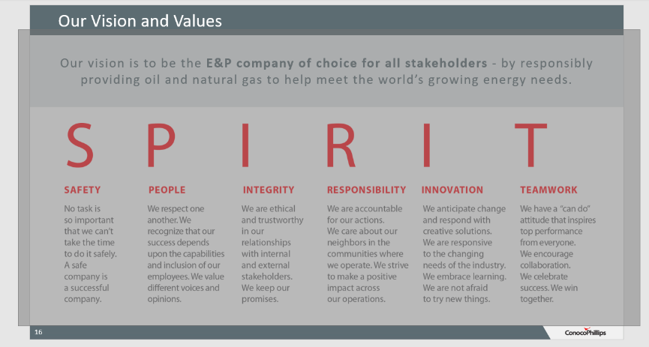
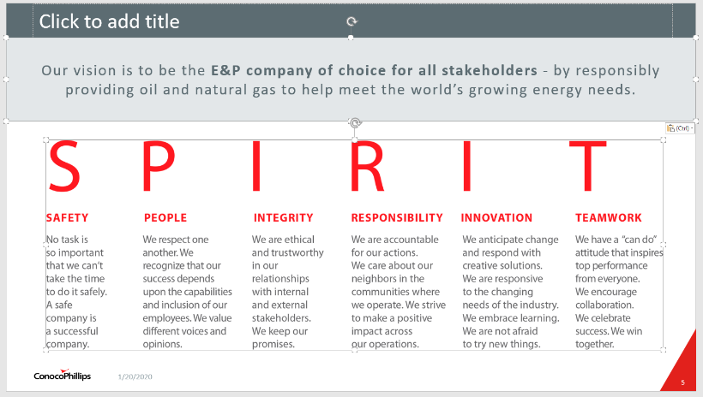
Migrating Content to New Template
To avoid formatting issues, it is recommended that you migrate old slides by copying and pasting content into a new presentation. Below is a quick guide:
Old Presentation
Go to the slide with content you want to migrate.
Click + hold your mouse down to drag a grey box over the entire content area of the slide.
Release the mouse to select the content.
Ensure that you didn’t copy the header, slide numbers or logo.
With the content boxes still selected, click CTRL + C to copy the content.
New Presentation
Click the down arrow next to New Slide and select your preferred “Title Only” slide to add it to your presentation.
Go to the new slide and click CTRL + V to copy your content into the blank slide.
Resize or adjust the content to fit the new template correctly.

Slide 10
Vertical Category
Horizontal Category

Slide 11
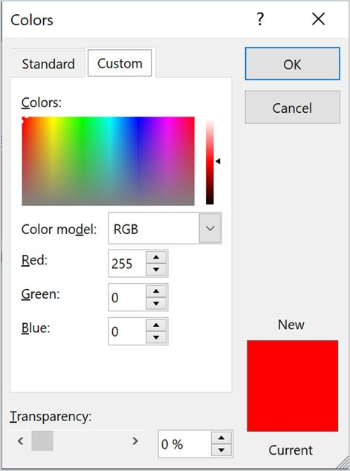
Approved Color Palette
Red
White
Black
Sample of how color values are found (RGB), right click, Custom tab
255/0/0
255/255/255
0/0/0
Secondary
Dark Gray
Dark Red
Orange
Yellow
92/108/114
199/40/37
245/127/41
255/199/9
Tertiary
Blue
Green
0/125/193
99/169/69

Slide 12
